Slide 1
To perform predictive analyses on a dataset and develop model using the Python programming language
Data Analytics and Visualisation
Student ID | Student Name
10612366 | Navin Kumar Singupuram

Slide 2
AGENDA
Aim of the assignment
Understanding the Dataset
Exploring the Data Visualisation Techniques
Exploring the Models using Data Mining Technique
Comparative Evaluation

Slide 3
DATA SET USED
Link for the dataset : Kaggle Dataset Repository
This information comes from a 2014 poll that assesses attitudes about mental health as well as the prevalence of mental health issues in the IT workplace.
In what ways does the prevalence of mental health disorders and societal attitudes towards mental health differ across various geographical regions?
What are the most significant factors that can predict the occurrence of mental health disorders or specific attitudes towards mental health within a work environment?
Used cleaning techniques after exploring dataset.

Slide 4
Data Visualization Techniques Used
HEAT MAP
Treatment correlation matrix – Heap Map
PAR PLOT
RELATIONAL PLOT
DISTRIBUTION PLOT
NESTED BAR PLOT

Slide 5
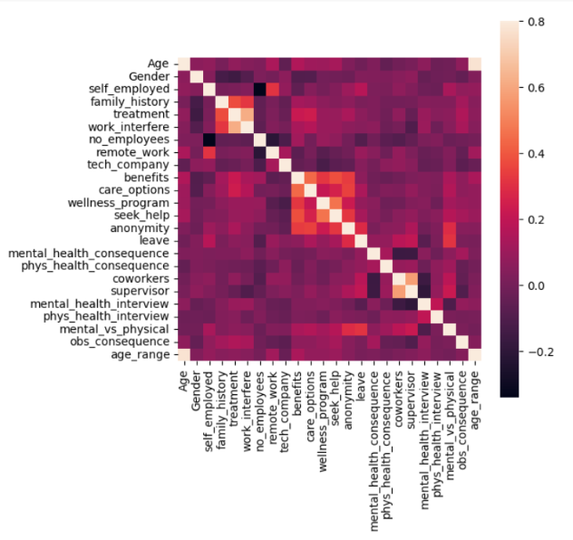
HEAT MAP PLOT
A correlation heat map is a type of graph that displays the strength of correlations between numerical variables

Slide 6
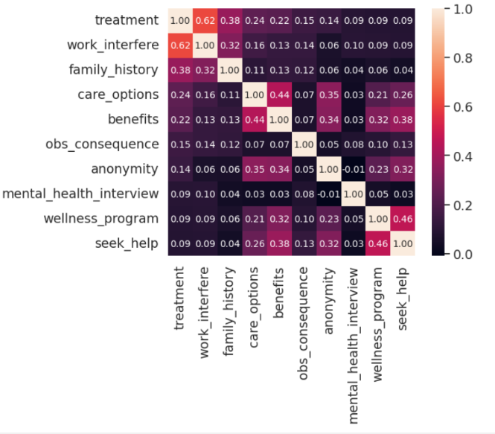
TREATMENT CORRELATION MATRIX - HEAT MAP PLOT
Correlation is a well-known statistic for measuring how similar two features are. If two characteristics are linearly related, their correlation coefficient is 1

Slide 7
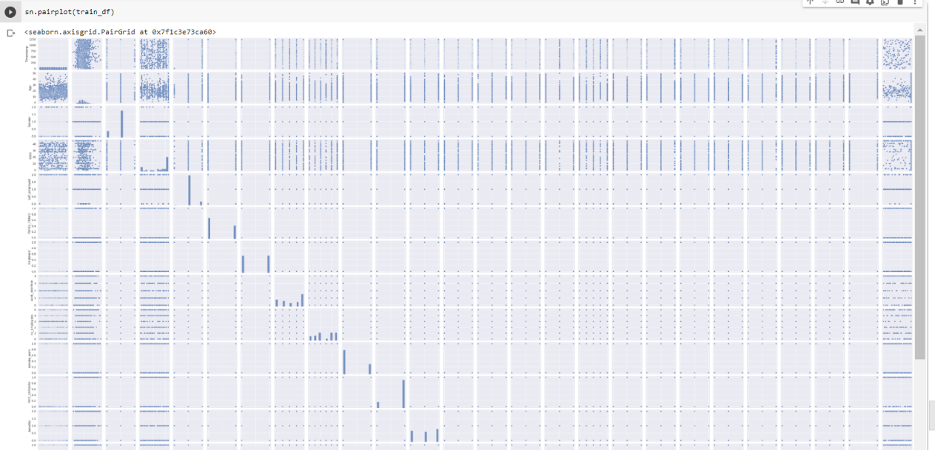
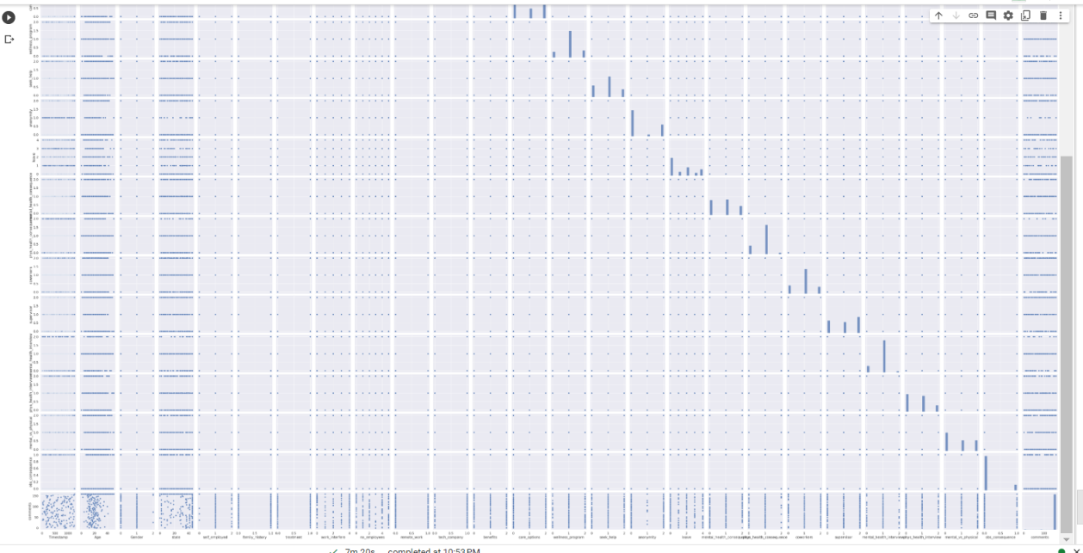
PAIR PLOT
A "pairs plot" scatterplot matrix aids in understanding the pairwise relationship between distinct variables in a dataset.

Slide 8
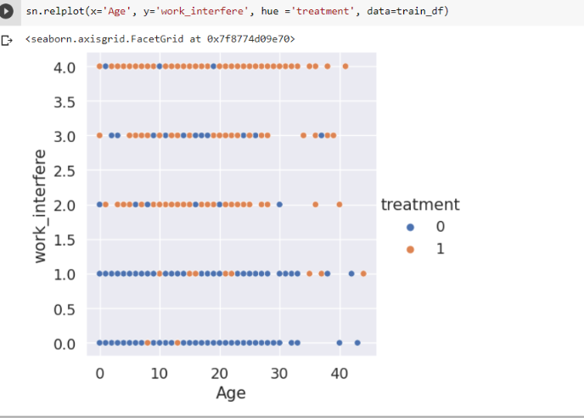
RELATIONAL PLOT
Relational graphs are used to represent the statistical relationship between the data elements.
Visualization is critical because it allows humans to detect trends and patterns in data

Slide 9
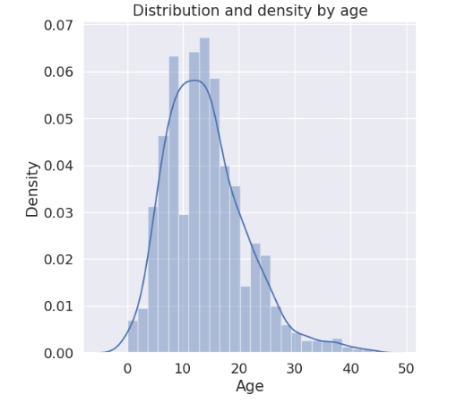
DISTRIBUTION PLOT
A distribution plot, or Dist plot, depicts the change in the data distribution. A sea born plot depicts the overall distribution of continuous data variables.

Slide 10
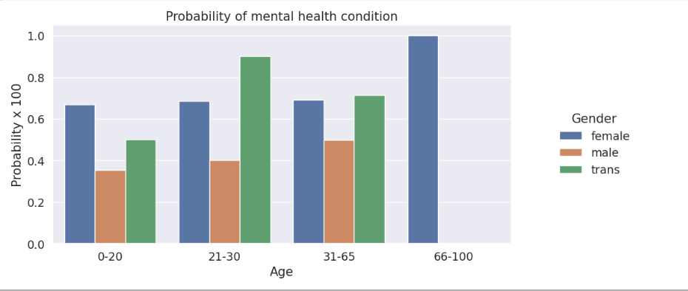
NESTED BAR PLOT
The bar plot which depicts the age on the x axis and the probability on the y axis through the mental health condition probability

Slide 11
EXPLORING MODELS EVALUATION
Logistic regression model
Multinomial logistic regression is a model where there are multiple classes that an item can be classified as.
KNN model with cross validation Score
Cross-validation is a technique where the data is split into multiple folds, and the model is trained and validated on each fold.
Decision Tree Classifier
Tuning a Decision Tree Classifier is an essential step in optimizing the model's performance.
max_depth, min_samples_split, min_samples_leaf, max_leaf_nodes

Slide 12
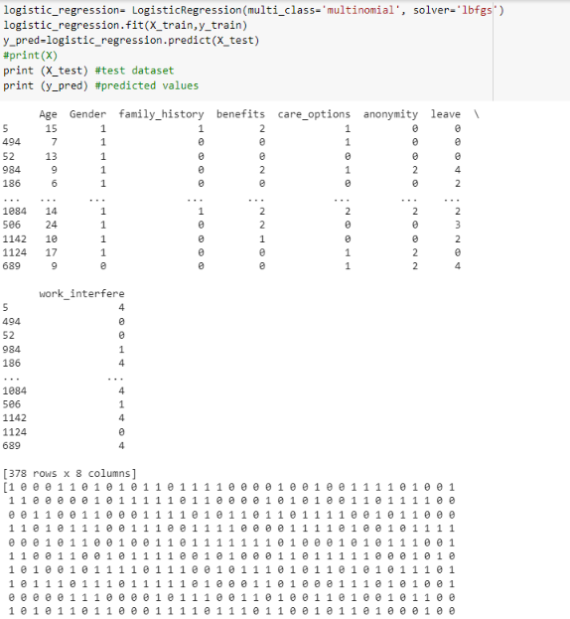
LOGISTIC REGRESSION

Slide 13
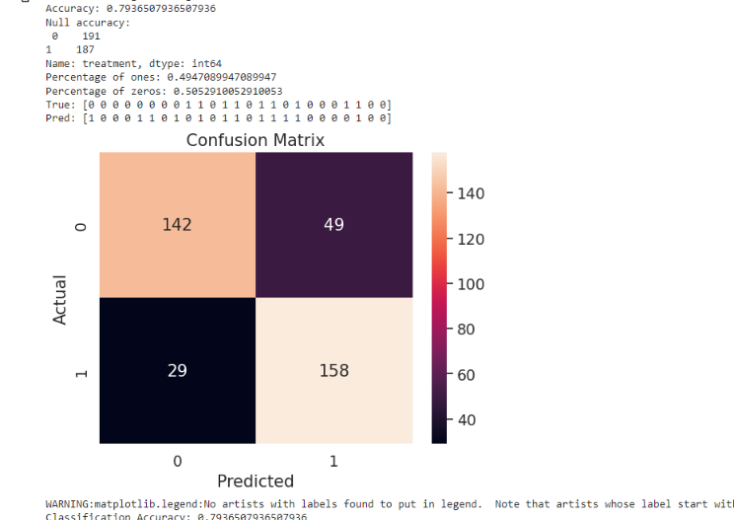
CONFUSIONMATRIX USING LOGISTIC CLASSIFIER

Slide 14
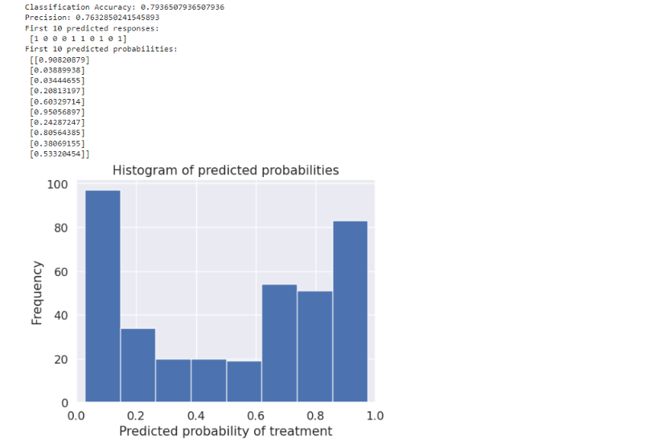
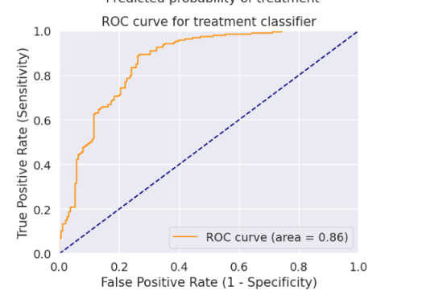
HISTOGRAM PREDICTION AND ROC CURVE

Slide 15
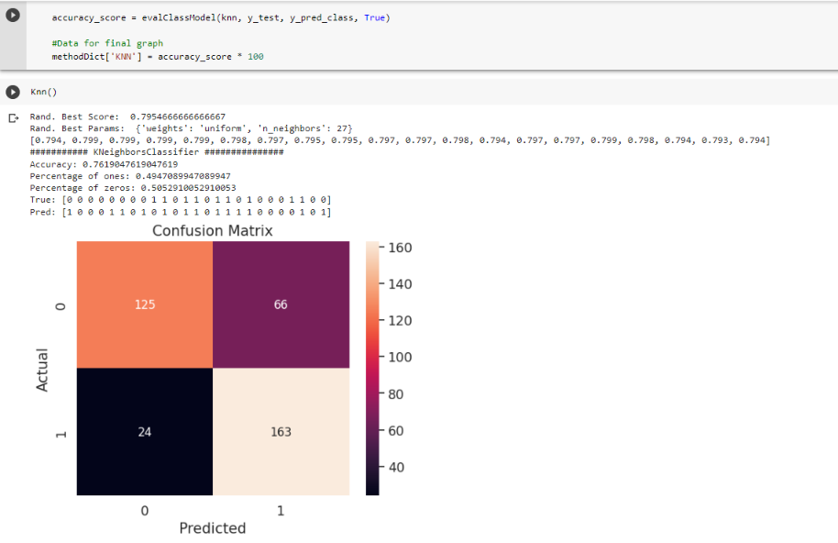
KNEIGHBORS CLASSIFIER WITH CROSS VALIDATION SCORE

Slide 16
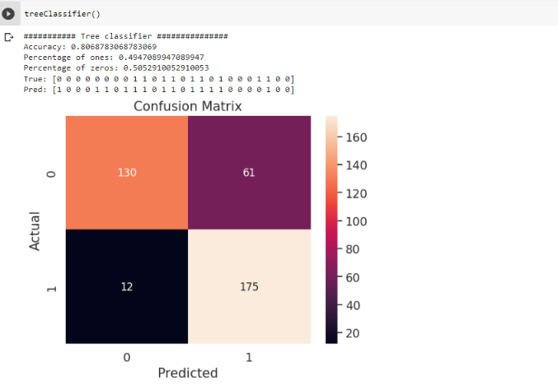
DECISION TREE CLASSIFIER

Slide 17
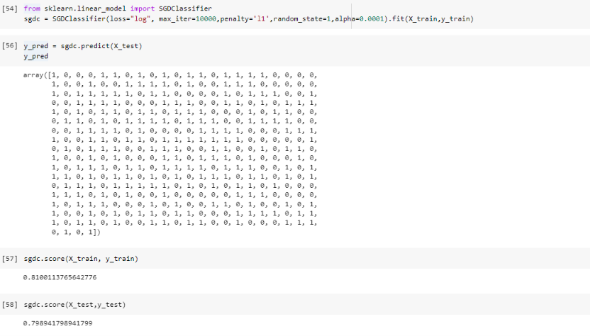
EXPLORING MODEL COMPARISON
Stochastic gradient descent (SGD)
It used to find the model parameters that correspond to the best fit between predicted and actual outputs. It's an inexact but powerful technique. Stochastic gradient descent is widely used in machine learning applications.
SGDC Classifier
Accuracy Score

Slide 18
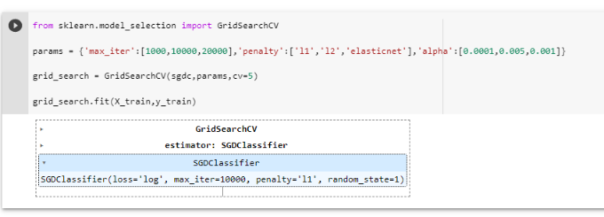
EXPLORING MODEL COMPARISON
Stochastic gradient descent (SGD)
It used to find the model parameters that correspond to the best fit between predicted and actual outputs. It's an inexact but powerful technique. Stochastic gradient descent is widely used in machine learning applications.
SGDC Classifier
FIT function on training Dataset

Slide 19
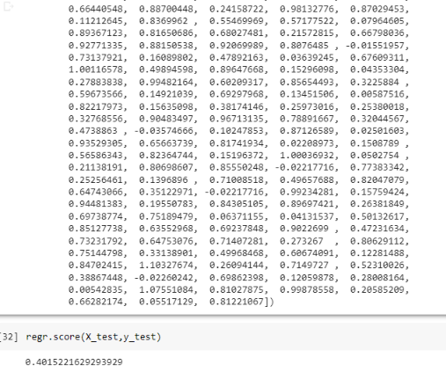
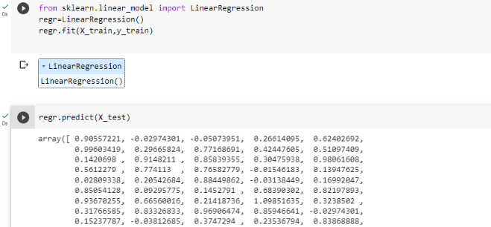
Training a Model
LINEAR REGRESSION

Slide 20
WHOA!
If you have any questions or doubts please reach out to me on
10612366@mydbs.ie
...

Slide 21

THANK YOU

